Slide 1
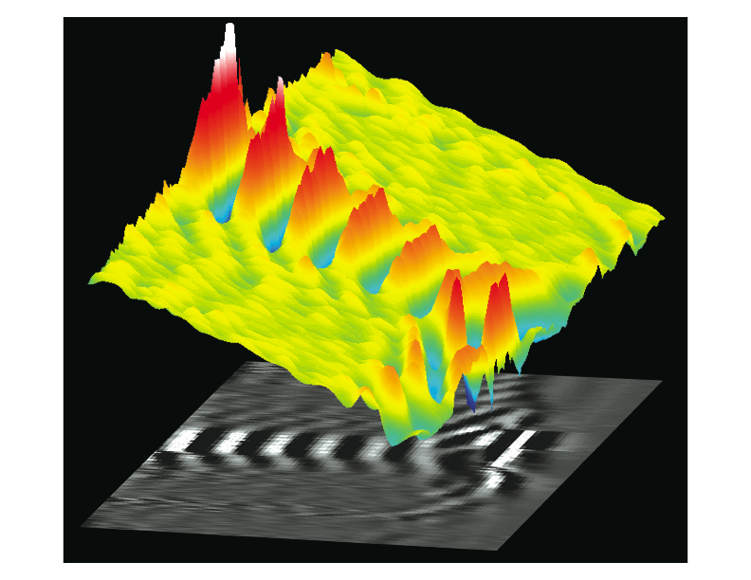
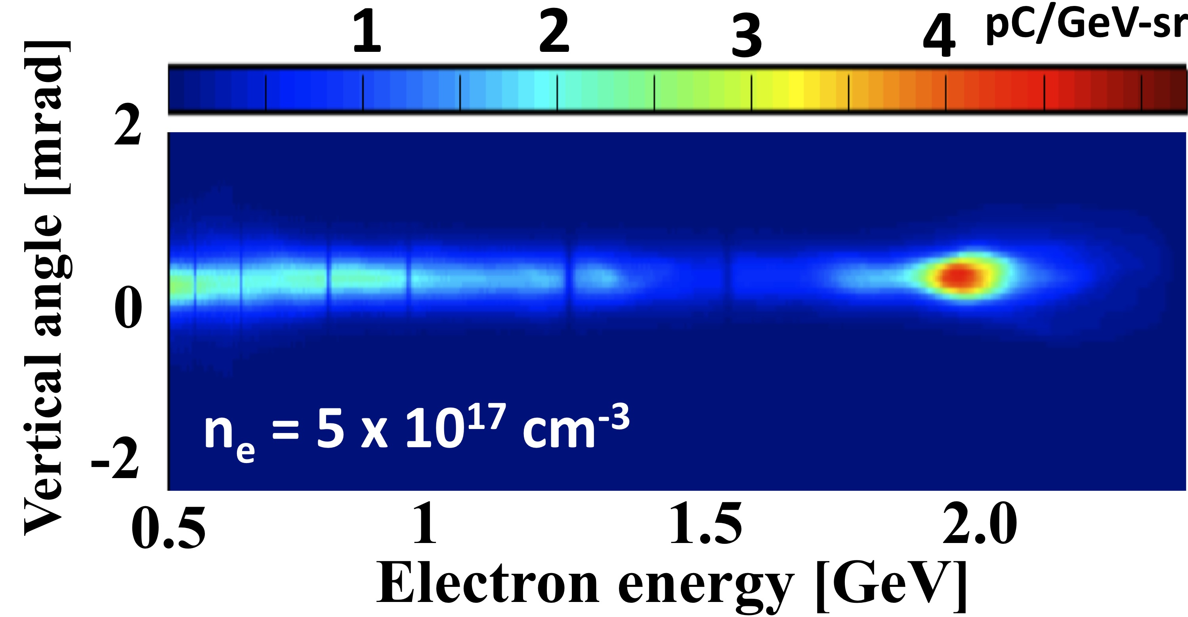
Plasma-Based Particle Accelerators:
There’s Plenty of Room at the Bottom*
Mike Downer
~ GV/cm
• TW → PW lasers
• MeV → GeV electrons
Wang et al., Nature Commun. 4, 1988 (2013)
2006
< 5%
record
~ c
< 0.5 mrad
100 µm
• VUV → hard x-ray
coherent
radiation
Matlis et al., Nature Phys. 2, 749 (2006)
100 µm
*Richard P. Feynman
1959 APS Meeting at CalTech
UT colloquium
October 16, 2013
Notes:
• My lecture demo is a 2” strand of my own hair, which represents the size of the accelerating channel of the GeV laser-plasma electron accelerators that I will tell you about today. These tiny accelerators can now do the job of a conventional accelerator > 1e4 x its size, or about 2 football fields long.
• The picture on the left shows a laboratory snapshot of a electron density (Langmuir) wave propagating at ~c thru a tenuous plasma in the wake of an intense laser pulse, inside which space charge fields reach ~GV/cm, > 1e4 x the breakdown field of a conventional metal accelerator.
• Plasma electrons captured within those fields can now reach energies as high as 2 GeV (see magnetically dispersed e- energy spectrum at the right) in a distance of only a few cm, an advance of 2x over the previous LPA record. Advances like this are spurred by the advent of PW lasers.
• But e- energy is only part of the story. The 2 GeV e- bunch has a record-setting angular divergence of < 0.5 mrad, and an energy spread (main part) of only ~ 5% which are critical to applications. Such features are the result of learning to observe, understand, manipulate and control PA accelerator structures on a µm spatial/fs time scale.
• That is the story I will tell today, and it prompted me to borrow the sub-title of Feynman’s 1959 lecture, widely viewed as a harbinger of the field of nano-technology. For those not familiar with Feynman’s lecture…

Slide 2
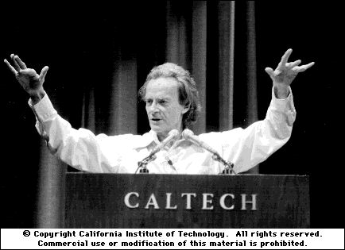
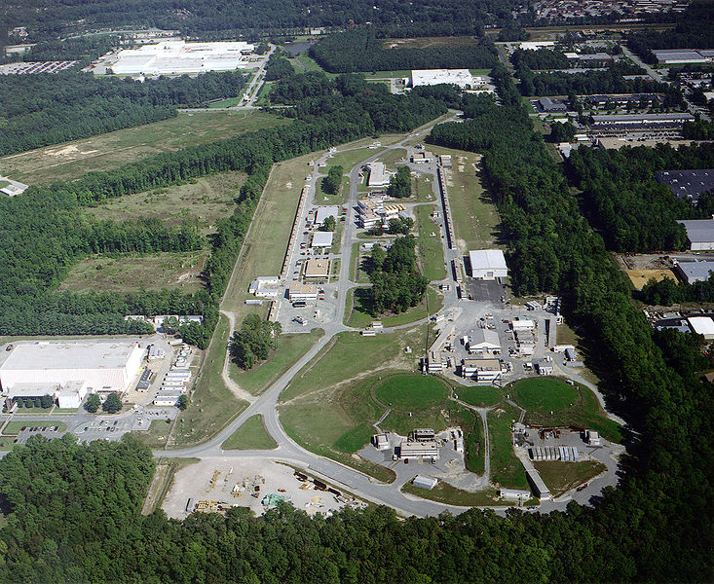
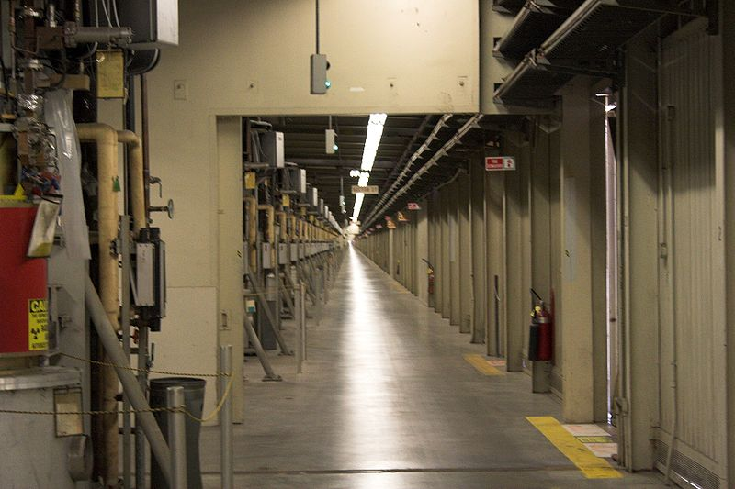
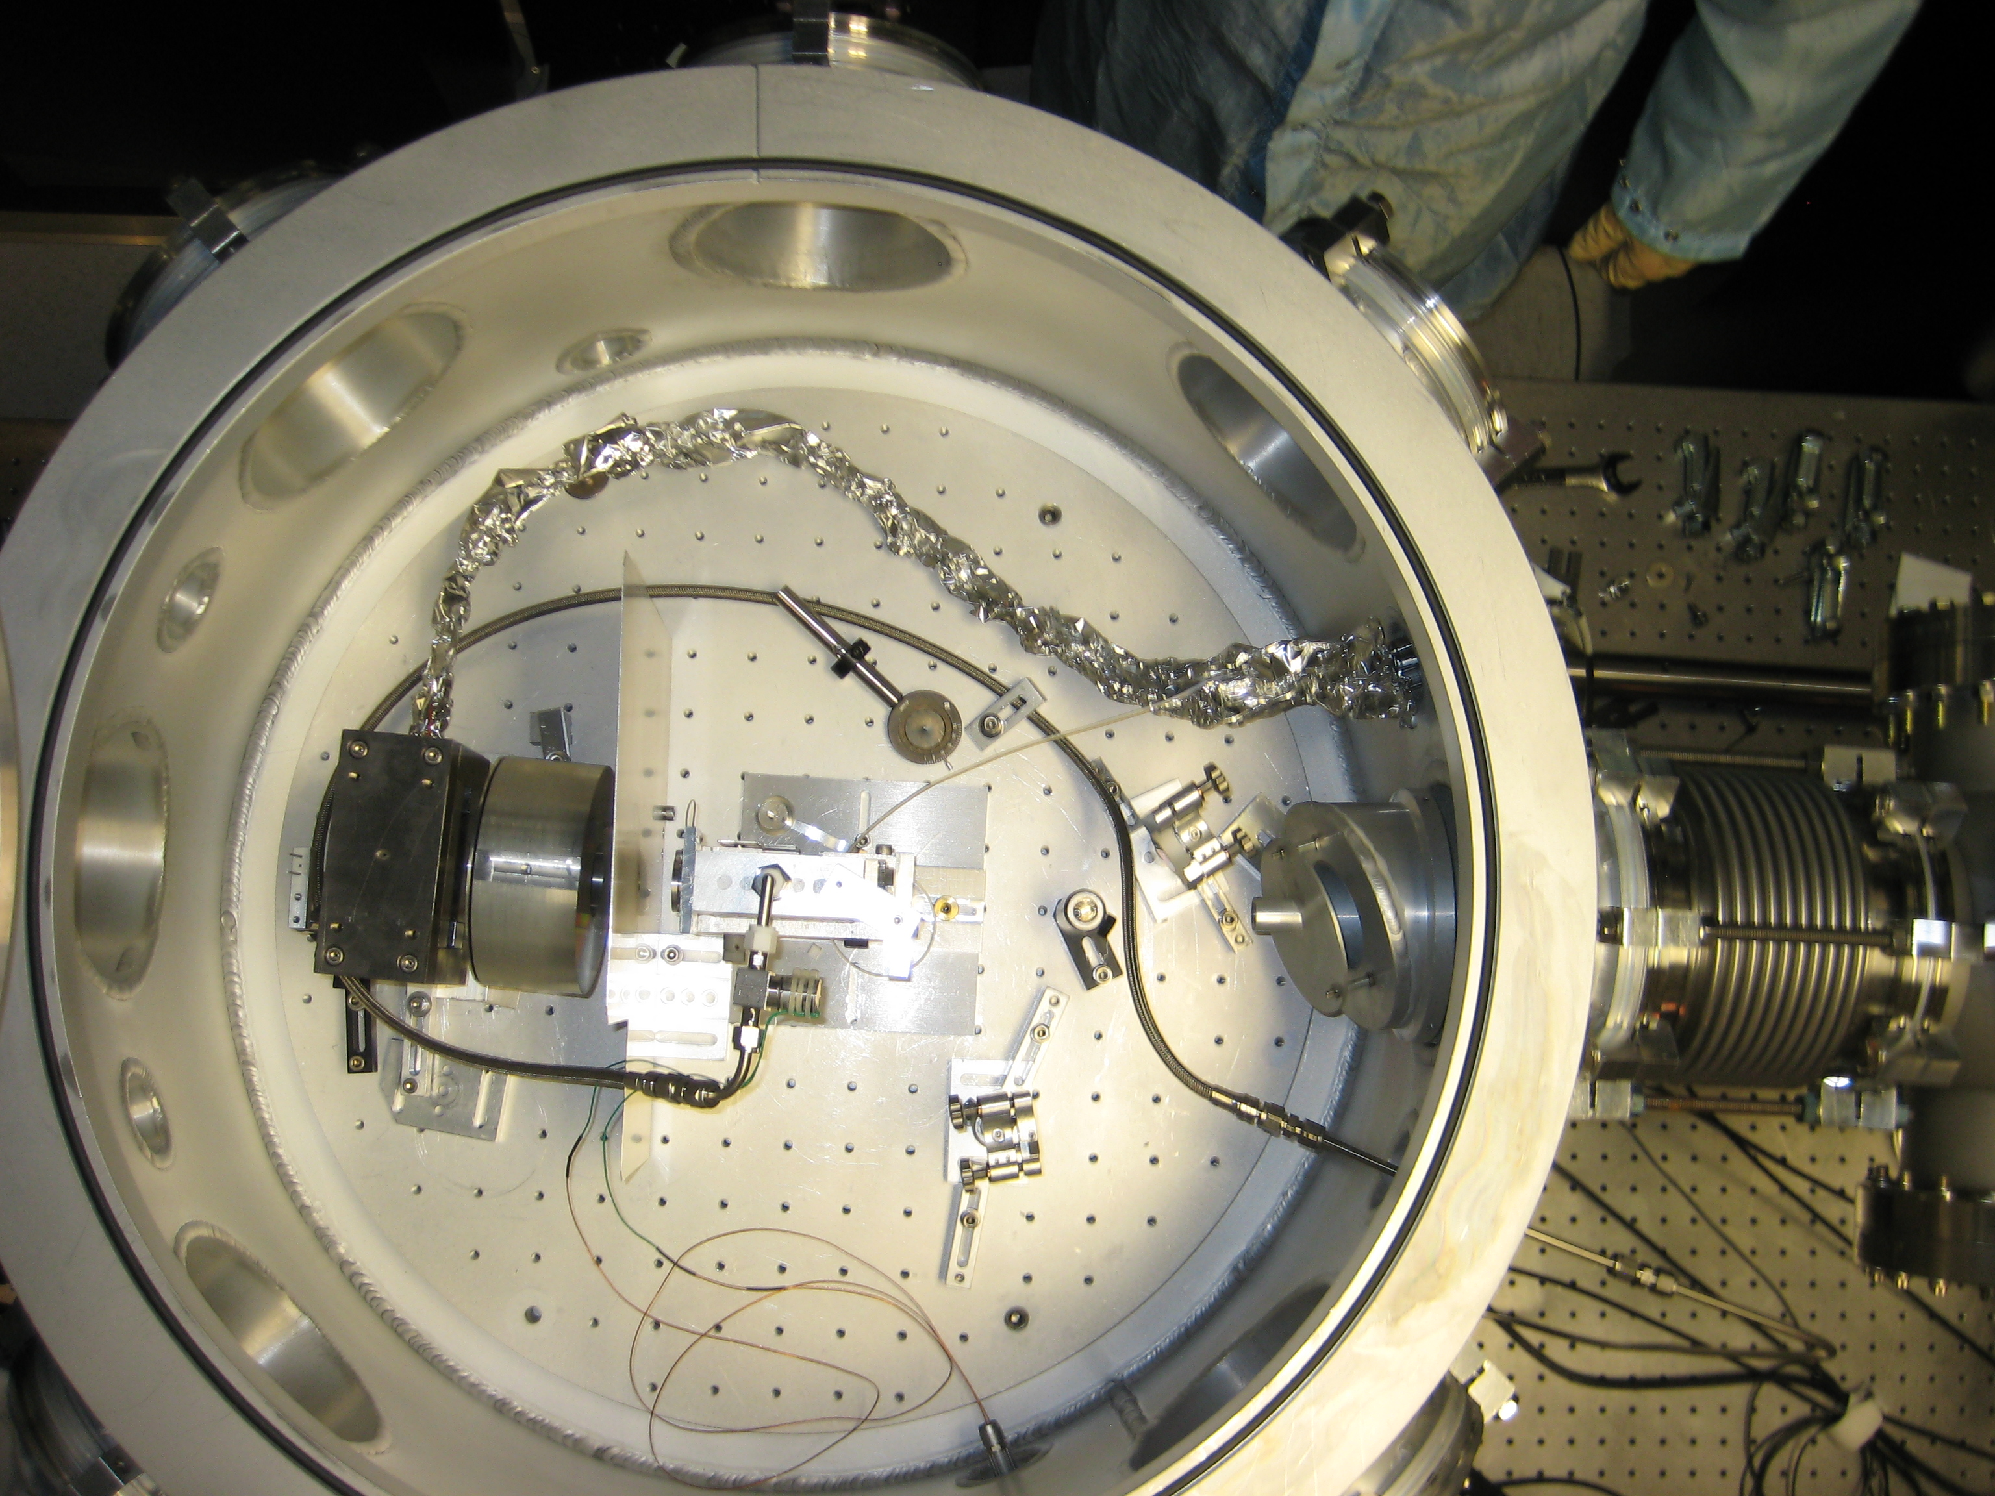
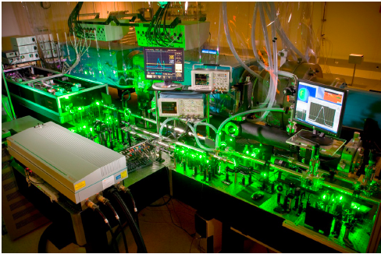
There’s Plenty of Room at the Bottom
I would like to describe a field [that]
… would have an enormous number
of technical applications: the problem
of manipulating and controlling things on a small scale....
Why cannot we write the entire 24 volumes of the Encyclopedia
Britannica on the head of a pin?
... all it is necessary to do is to reduce in size all the writing in the
Encyclopedia by 25,000 times.... A period would contain 1000 atoms.
one
< 10 fs,
0.1 nC
bunch/hr
(10⁴ A peak;
10⁻¹³ A avg)
continuous
~ 10⁻⁴ A
e-beam
1 foot
WPE:
~0.1
WPE:
< 10⁻⁷
Texas 2 GeV
accelerator
Klystron hall
Texas PW Laser
Jefferson 6 GeV Accelerator Lab
Notes:
… here are a few of its key passages that are relevant to the subject at hand.
• Jefferson Lab: WPE ~0.1, continuous 200 µA beam
• TPW-LPA: WPE < 1e-7, one ~10 fs, 0.1 nC bunch/hr (< 1e-7 µA)

Slide 3
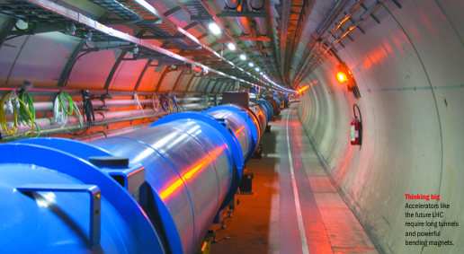
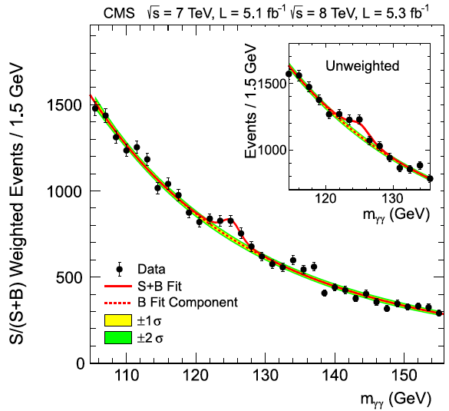
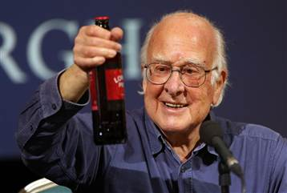
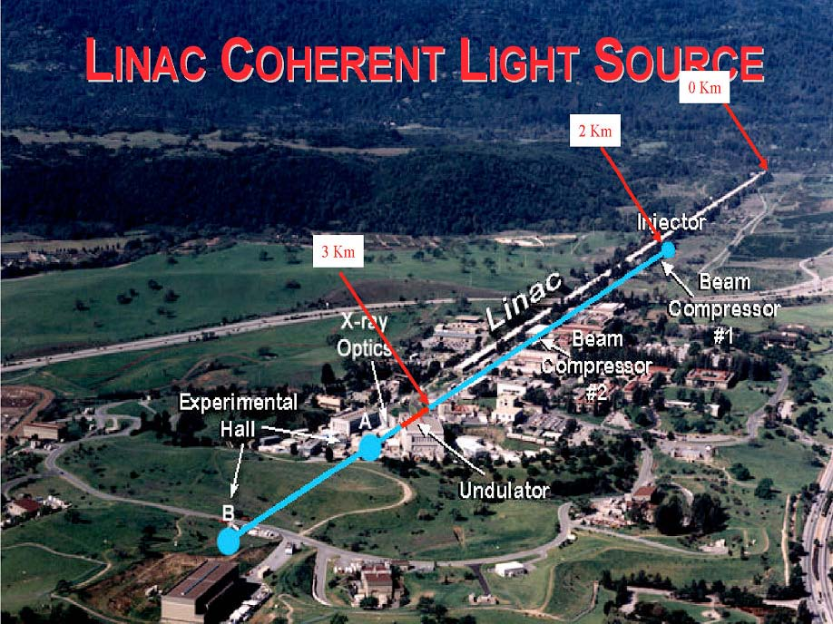
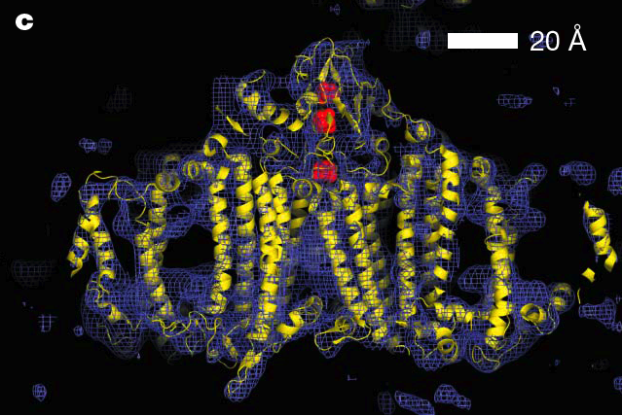
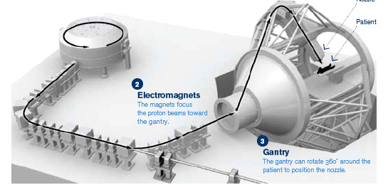
Particle accelerators have evolved into the 21st century’s
most powerful* scientific instruments
* and largest and most expensive
$6 B
CERN-LHC
TeV:
$0.5 B
Membrane protein Photosystem I
2 km
GeV:
3 km
linac
injector
x-ray optics
Experimental
hall
undulator
Chapman et al., Nature 470, 73 (2011)
GeV Laser-Plasma electron accelerators are poised to transform biology, chemistry and physics
by putting table-top femtosecond X-ray free-electron lasers in every major research university
cyclotron
patient
Laser
MeV protons
Laser proton accelerators are poised to miniaturize cancer therapy…
Jung, PRL 107, 115002 (2011)
…and ignite fusion
Fernandez, Nucl. Fus. 49, 065004 (2009)
MeV:
magnets
$0.2 B
Target
e⁻ cloud
gantry
H-rich film
Notes:
Make point about table-top x-ray sources and their importance for science on this slide.
Jung, PRL 107, 115002 (2011) – recent proton acceleration results
Fernandez, Nucl. Fus. 49, 065004 (2009) – ignition of laser fusion

Slide 4

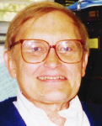

Electrons Accelerating on a Laser-Driven Plasma Wave
Tajima & Dawson, Phys. Rev. Lett. 43, 267 (1979)
Accelerating Field:
plasma wave
Tajima
trapped e-
laser
pulse
Dawson
externally
injected
“hadron”
n_{e}
self-injected
“electrons”
δn
2x10⁹ V/cm
4x10¹⁸ cm⁻³
1 GeV
0.7x10⁹ V/cm
n_{e0}
5x10¹⁷ cm⁻³
7 GeV
~10⁵ V/cm
(conventional accelerators)
z
Gas Jet Fires
Acceleration Length:
Laser Pulse Focuses
0.1 to 10 cm
Ionize Gas & Make Wave
0.5 cm
4x10¹⁸ cm⁻³
1 GeV
9.5 cm
5x10¹⁷ cm⁻³
Helium Gas Jet
7 GeV
Wave Captures and
Accelerates Electrons
>10⁵ cm
(conventional GeV accelerators)
PW peak power needed to self-guide and
self-inject at < 10¹⁸ cm⁻³ plasma density
Notes:
Laser pulse duration chosen to excite plasma wave RESONANTLY.

Slide 5

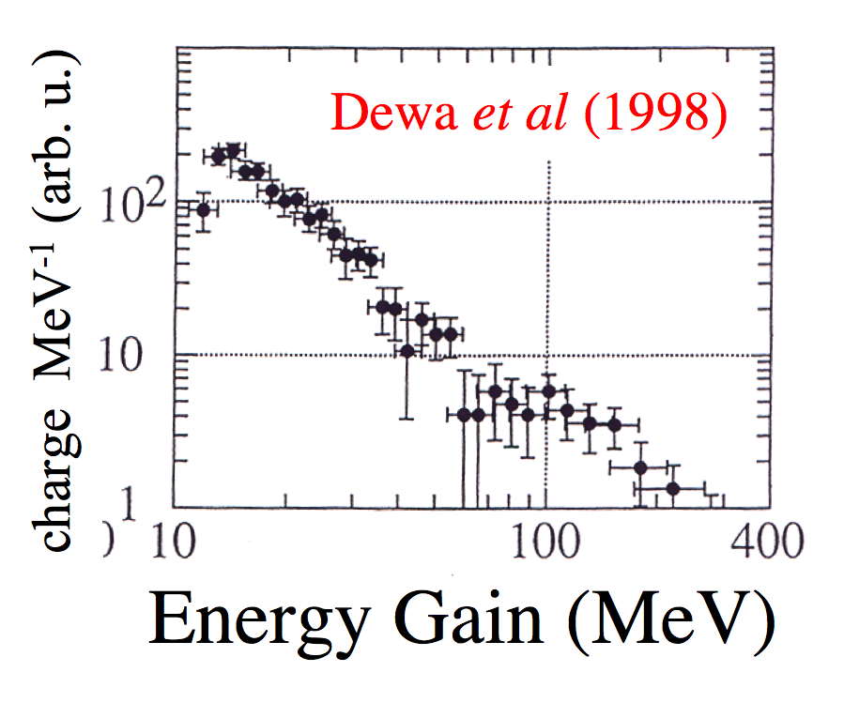
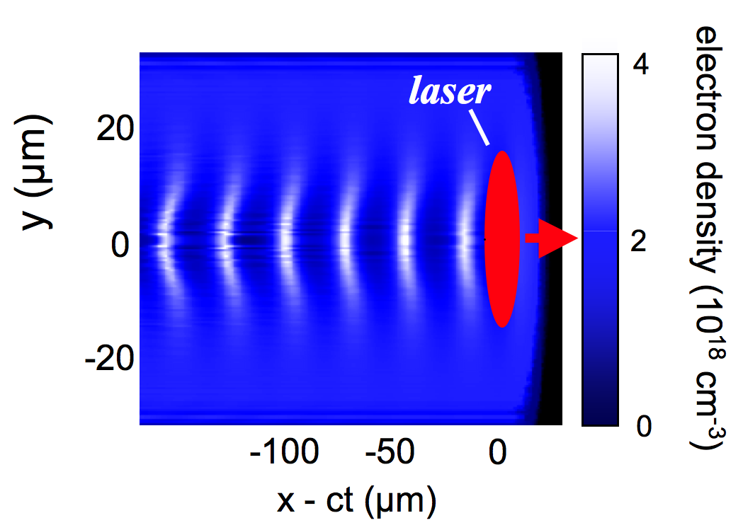
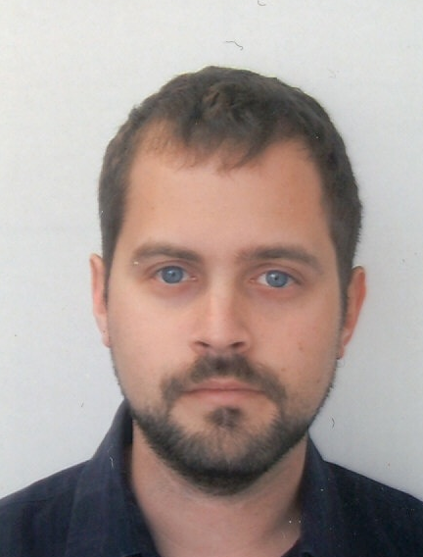
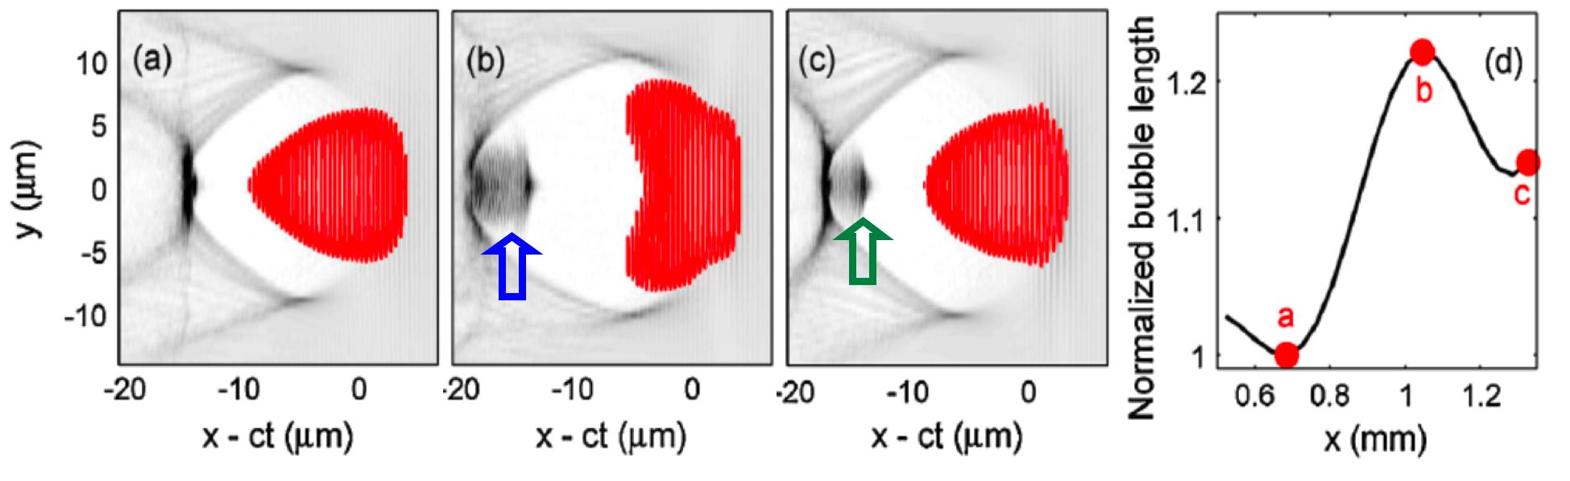
Today, most LPAs operate in the “bubble” regime…
Pukhov and Meyer-ter-Vehn, Appl. Phys. B 74, 355 (2002)
Review: Esarey, Rev. Mod. Phys. 81, 1229 (2009)
sinusoidal wake
Before 2004:
Ishay Pomerantz, “An
ultra-short pulsed neutron
source,” AMO Seminar,
Oct. 11, 2013
Leemans, Nat. Phys.(2006)
plasma bubble
After 2004:
500
Kalmykov (2009)
10
Kalmykov PRL (2009)
E = 1 GeV
∆E/E = 5 %
θ_{div} = 5 mrad
Q ~ 0.1 nC
t_{bunch} < 10 fs
I_{peak} ~ 100 kA
Kalmykov (2009)
Geddes, Nature (2004)
Faure, Nature (2004)
Mangles, Nature (2004)
250
5
pC GeV⁻¹
electron density (10¹⁸ cm⁻³)
x = 0.3 mm
x = 0.6 mm
0
x = 0 mm
0
0
500
1000
Energy Gain (MeV)
... because point-like injection enables quasi-monoenergetic acceleration
Notes:
Lead-in: One of the most important discoveries along the 20-year path to mature TW-LPA was that the quasi-linear sinusoidal waves depicted in the previous slide produced electrons with wide energy spread, because of the difficulty of injecting electrons into the wave with sub-plasma-wavelength precision.
• In 2004, we learned that a highly nonlinear regime in which the drive pulse creates an electron density “bubble”, in a remarkable act of self-organization, gives rise to highly mono-energetic electrons up to 1 GeV in energy, as depicted here.

Slide 6
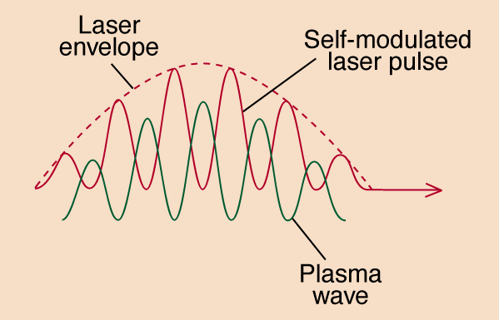
The bubble regime offers trade-offs in de-
signing multi-GeV LPAs – e.g. pulse duration
Wei Lu et al., Phys. Rev. Special Topics - Accel. & Beams 10, 061301 (2007)
“Generating multi-GeV electron bunches using single stage laser wakefield acceleration in a 3D nonlinear regime”
Pulse duration (ω_{p}τ < 1)
is necessary to avoid
Raman instability …
… but within that broad limit, we have choices:
~
τ = 30 fs, 1 PW pulse
(all those other guys)
τ = 150 fs, 1 PW pulse
(Texas PW)
Greater pump depletion length L_{pd}
100
150 fs
10
Pump depletion
length [cm]
unstable
30 fs
1
10¹⁹
10¹⁸
10¹⁷
Plasma density n_{e} [cm⁻³]
Notes:
Lead in to next slide with: “Now, putting together the accelerating field, dephasing and pump depletion lengths, and options regarding pulse duration and guided a0, we arrive at a plot of accelerated electron energy vs. plasma density…”

Slide 7


Two complementary INITIAL approaches to PW, multi-GeV
laser-plasma acceleration are emerging
I
Plasma density n_{e} [cm⁻³]
Texas PW theoretical limit
10¹⁹
10¹⁸
10¹⁷
(plenty of room for improvement
“at the bottom”)
100
SLAC
ω_{p}τ: 0.2 → 1
10
Previous TW
LPA
experiments
(1992-2012)
Electron energy gain ∆W [GeV]
1
Wang
(2013)
Short-pulse PW theoretical limit
Texas PW
“Short Pulse PW”: τ_{L} ~ 30 fs, E_{L} ~ 30 J
“Long Pulse PW”: τ_{L} ~ 150 fs, E_{L} ~ 150 J
• plasma channel guiding (best near 10¹⁸ cm⁻³)
• self-guiding
• up to 1 pulse/s
• 1 pulse/hour
• limited to < 10 GeV by pump depletion
• theoretically capable of ~30 GeV
Notes:
Lead-in: Putting together the considerations of the previous slides, energy gain ∆W is inversely proportional to plasma density n_{e}, with a band of possibilities determined by pulse duration (i.e. pump depletion length) and guided intensity a₀.
Previous TW experiments had to be conducted at ne > 2e18 cm-3, for the reasons discussed, and were therefore capped at ∆W ~ 1 GeV.

Slide 8
OUTLINE
1) Initial 2 GeV PW-laser-driven e- acceleration results
• highest LPA energy to date
• lowest beam divergence (< 0.5 mrad) from an LPA
• lowest plasma density (n_{e} ~ 3e17 cm⁻³) for an LPA
2) How do we improve upon these results?
• robust plasma channels at n_{e} ~ 10¹⁷ cm⁻³
• specialized injection techniques yielding ∆E/E < 1%
• 4D single-shot laboratory visualization of laser wakes
3) Wider vision of plasma-based accelerators

Slide 9
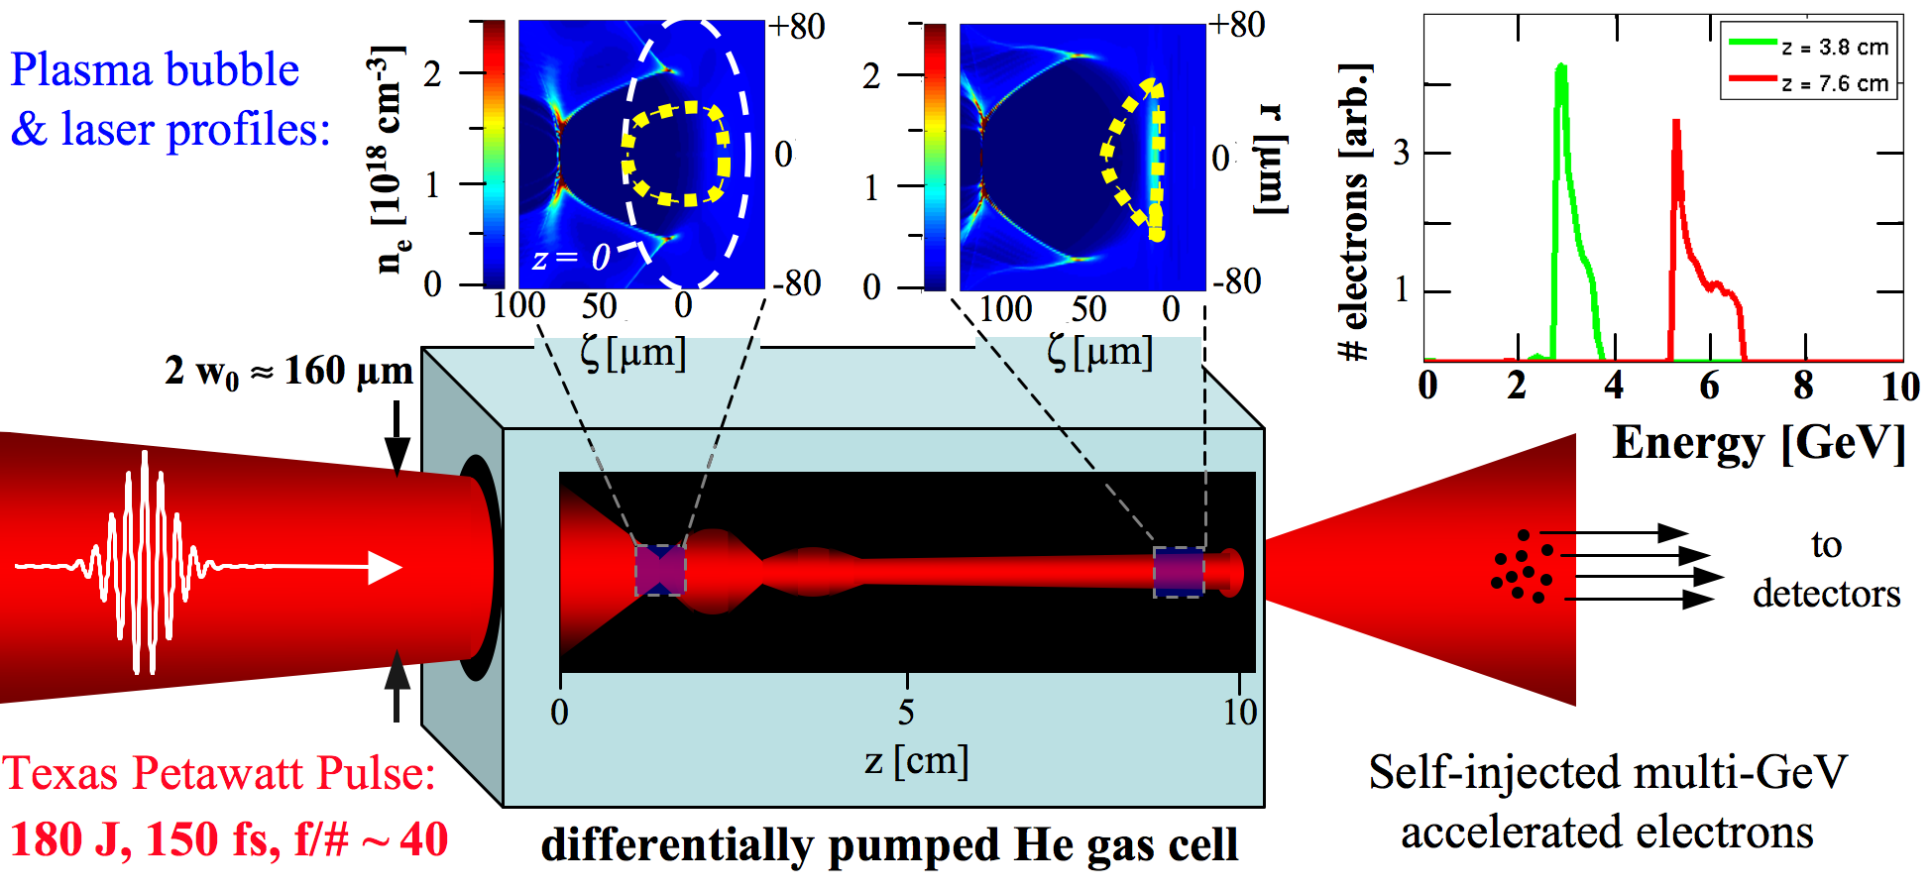
Experiments at the Texas Petawatt Laser aim to produce
quasi-mono-energetic multi-GeV e⁻ beams in one 10 cm stage
Kalmykov et al., New J. Physics 12, 045019 (2010)
“Numerical modeling of multi-GeV laser wakefield accelerator driven by self-guided petawatt pulse,”
100
KEY DIFFERENCES FROM PREVIOUS EXPERIMENTS:
Lower n_{e} (10¹⁷ vs 10¹⁹ cm⁻³): longer dephasing (L_{d}) & pump depletion (L_{pd}) lengths
Longer interaction (8 cm gas cell vs < 1 cm jet): to exploit longer L_{d} and L_{pd}
Longer τ_{pulse} (150 fs vs < 60 fs): to excite plasma waves resonantly
Higher peak power (~ 1 PW vs < 0.18 TW): to self-guide, create plasma bubble,
trigger self-injection at low n_{e}

Slide 10

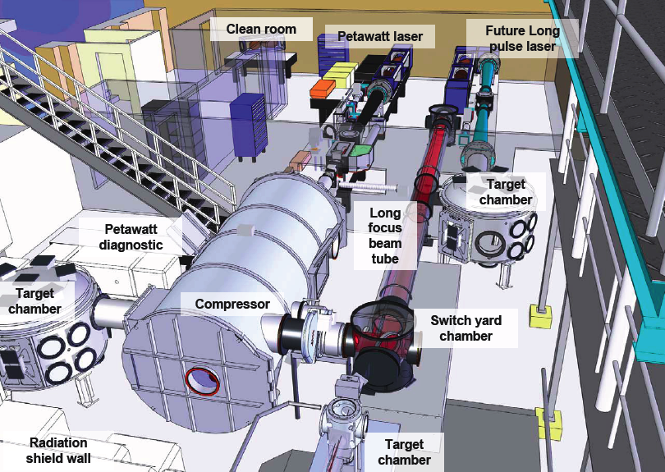


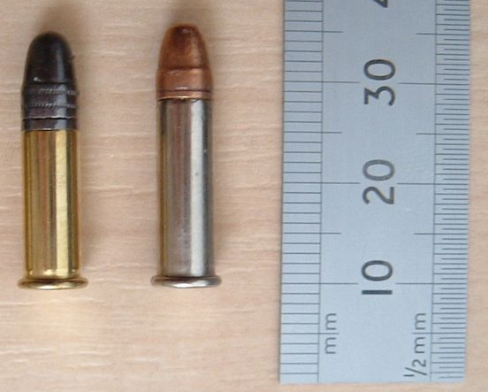
The Texas Petawatt Laser delivers 1.05 µm,
150 fs pulses up to 150 J on target
150 fs = 1 plasma oscillation
period at n_{e} = 3•10¹⁷ cm⁻³
Final mixed glass amplifier from NOVA
150 J = muzzle energy
of .22LR caliber
pistol bullet
f/40
Wakefield
E. Gaul et al., Appl. Opt. 49, 1676 (2010)
Notes:
Mention that only ≤100 J used so far in experiments.
BELLA:
• 300 m^2 (laser) + 80 m^2 (target bay) • single-purpose facility • up to 1 Hz • 40 fs, 40 J • high Strehl ratio • “world’s most powerful laser”
TPW:
• 200 m^2 (laser) + 50 m^2 (target bay) • multi-purpose facility • 1 pulse/hour • 150 fs, 150 J • low Strehl ratio (currently)* • “world’s most powerful laser”
* So energy coupled into plasma is probably about the same as with BELLA.

Slide 11
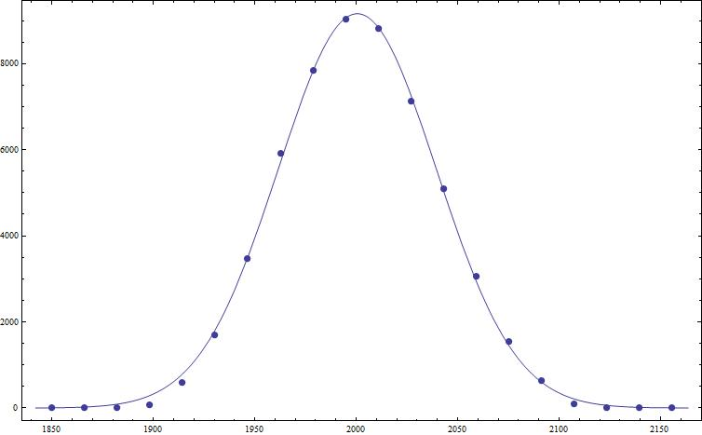
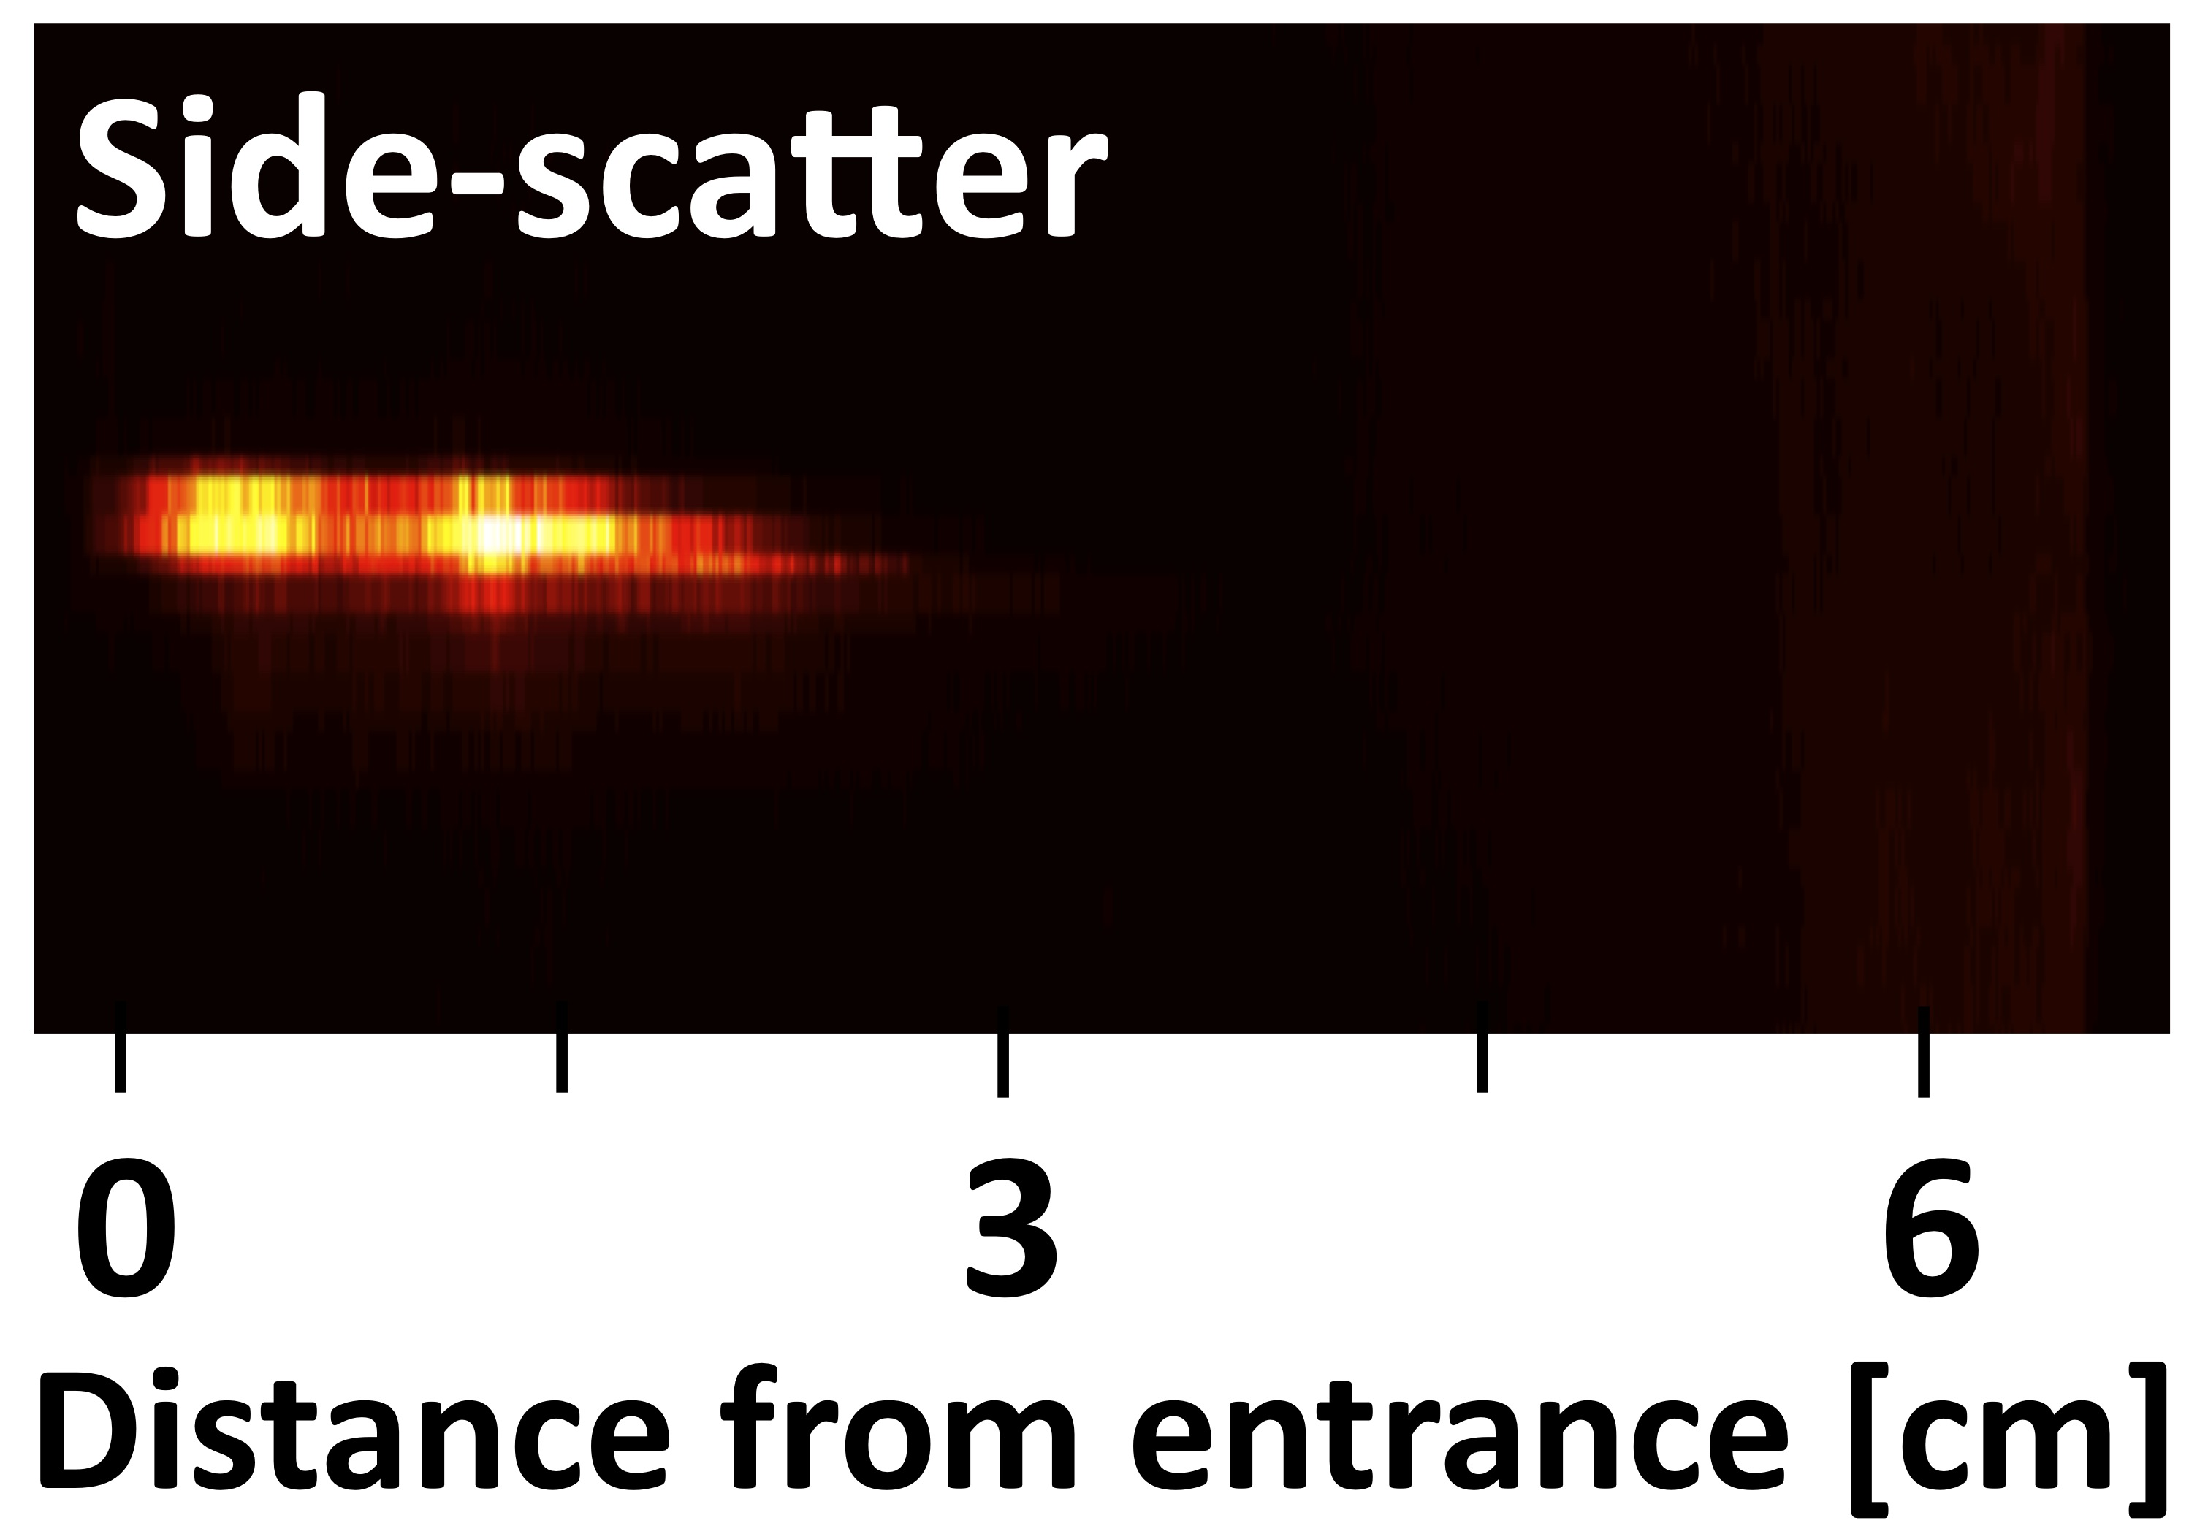
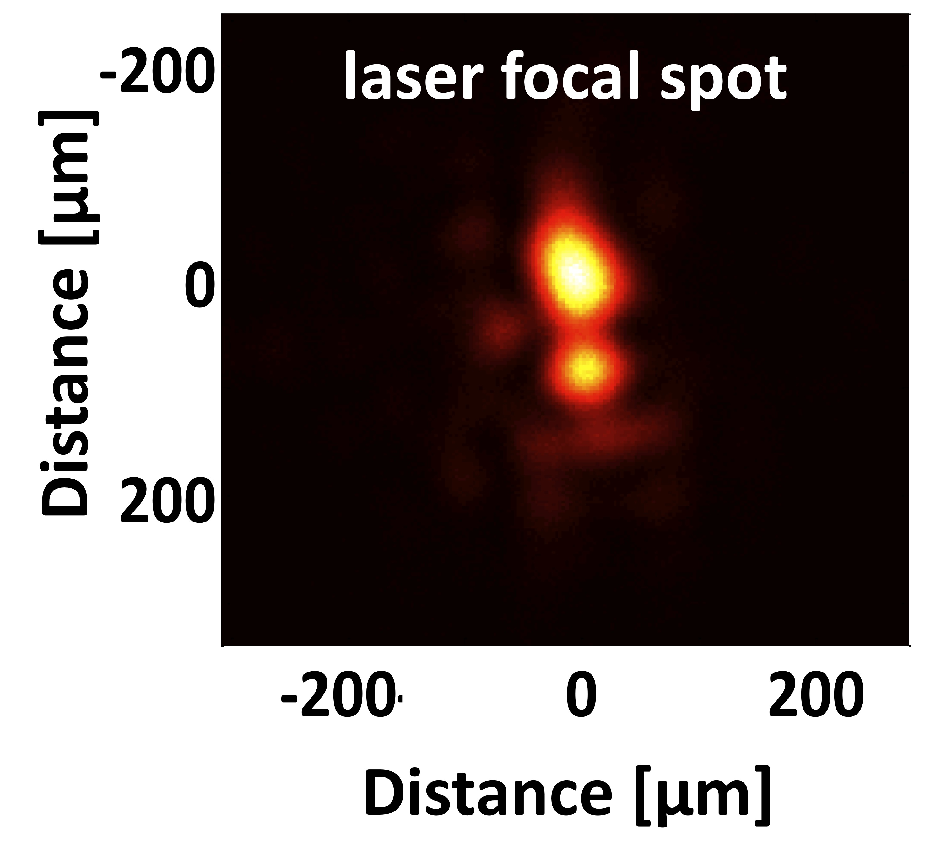
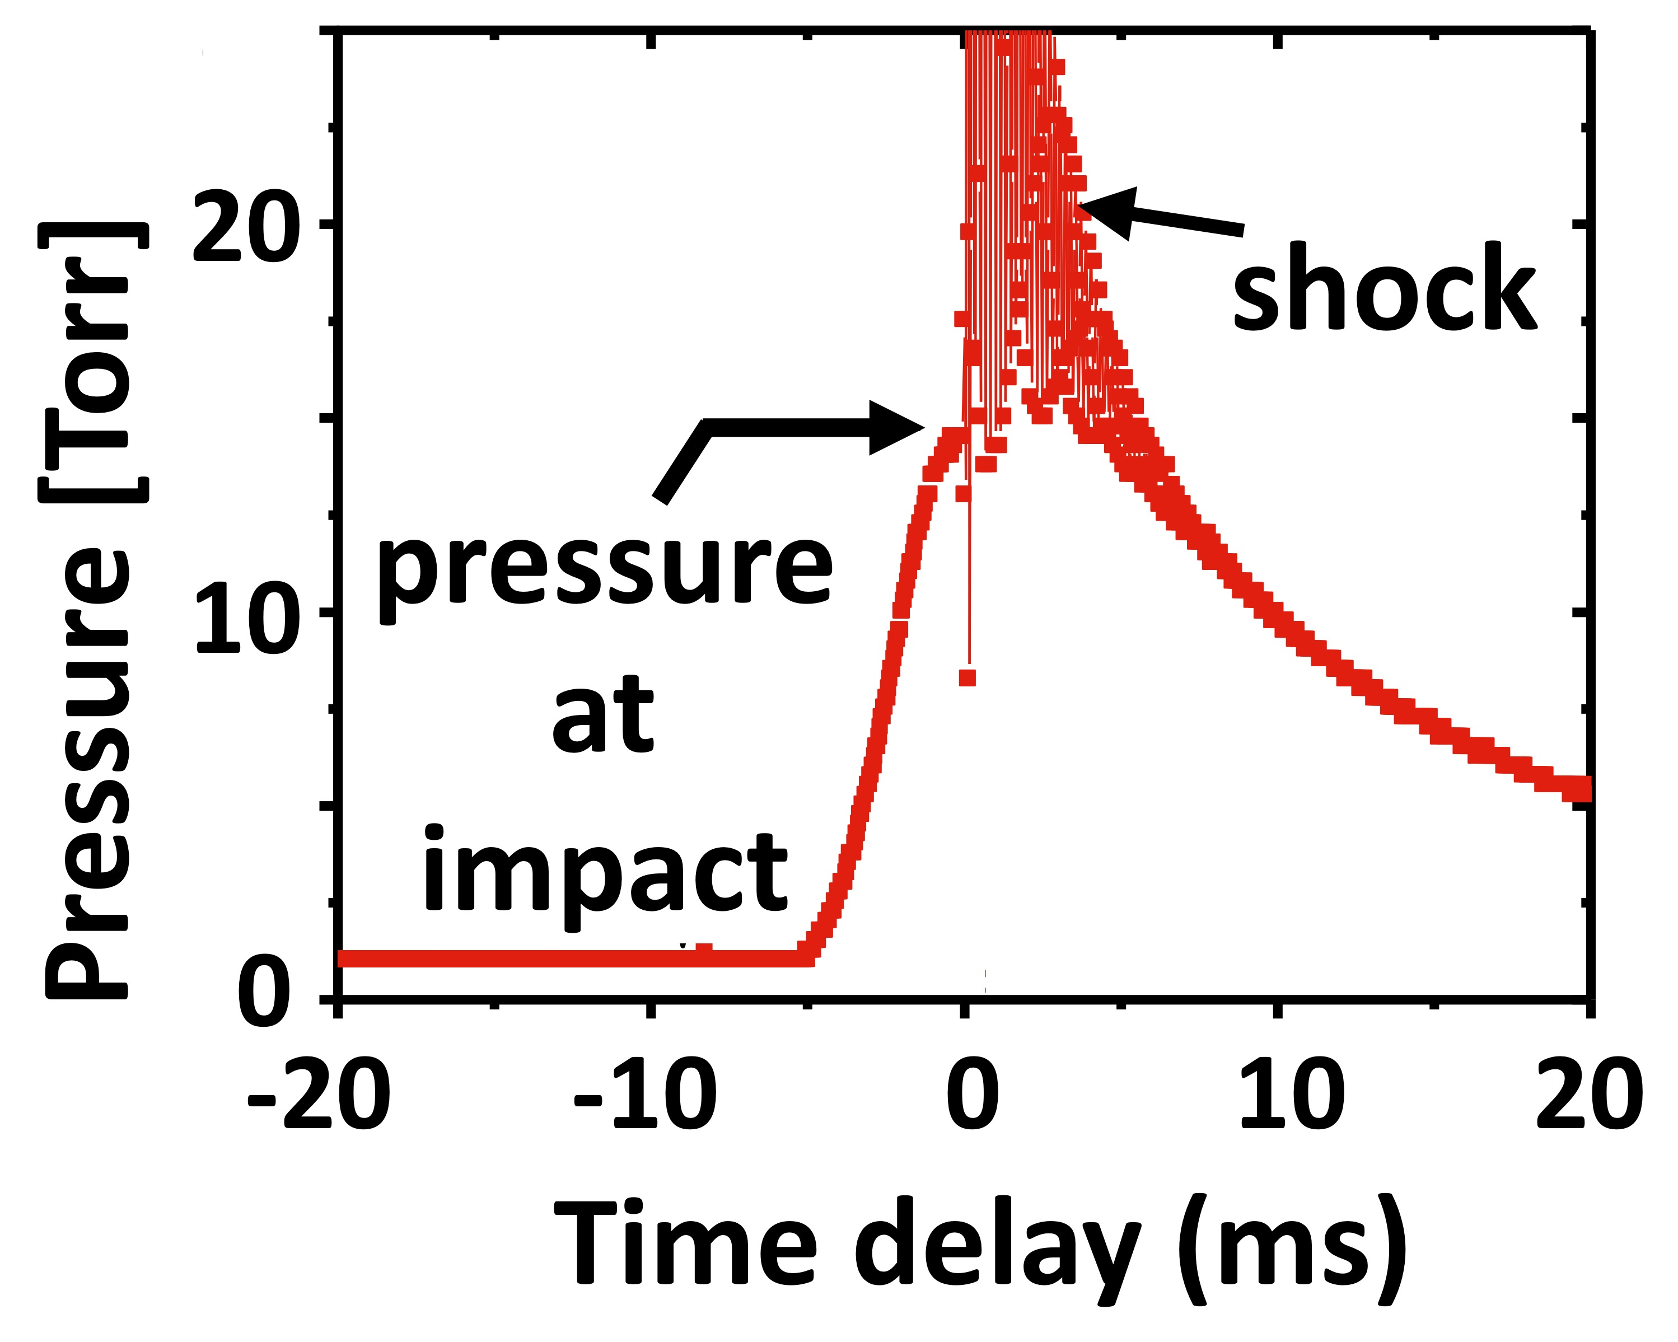
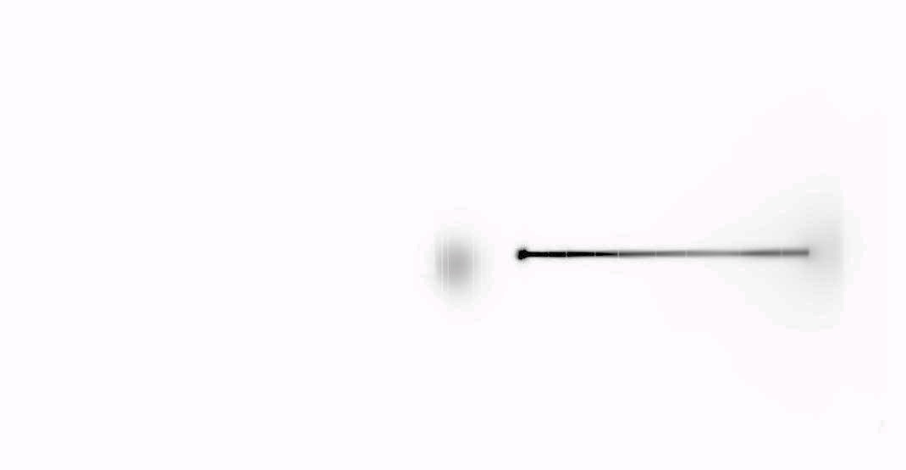
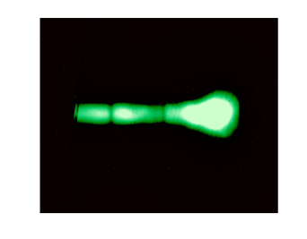
Experimental setup emphasizes high precision & redundancy in e- energy measurement up to 2 GeV
Scale drawing of magnetic spectrometer:
IP
magnet
0
1.0 m
2.0 m
2.5 m
x-ray source
0.8
2.0 GeV ± 5% (2σ)
0.6
0.4
Probability
2σ
Beam
dump
0.2
0
CCD
1.9
2.0
2.1 GeV
≤ 120 J 150fs
optical filters
1.1 T
6.7 cm
laser
Tungsten wire fiducial arrays
IP_{HS} IP_{HR}
gas cell
magnet
x-rays
electrons
CCD
laser
polarization
pressure sensor
vacuum
IP_{LE}
Al deflector
Deflection from axis [cm]
scintillators
5
20
10
0
Raw IP data
fiducial shadows
θ [mrad]
2.0
θ [mrad]
-5
electrons
x-rays
-2.0
0.5
1.0
2.0
Energy [GeV]
1.0
2.0
Energy [GeV]
Notes:
Here is a schematic diagram of the experiment. In our diagnostics, our goal was to build redundancy into our diagnostics.
TPW laser pulse enters gas cell
-> show laser focal spot
2) The actual focal spot was typically far from a gaussian, having multiple hot spots,
3) the gas cell is filled with He
-> show pressure sensor and comment on pressure in the gas cell just before and after the pulse arrival
4) it creates and then interacts with the plasma
-> show side-scatter image
5) RSFs, creates bubble, is guided, self-injection and acceleration of electrons take place
6) the laser pulse is sent to a beam dump by a thin Al deflector placed in its path
6) and the self-injected and accelerated electrons leave the gas cell, enter a magnetic spectrometer, are deflected by it. Low energy electrons are recorded on an imaging plate not from the magnet,
-> show raw high-E IP picture
7) and the high-energy one (> ~350 MeV), as well as the betatron x-rays, traverse the diagnostic chamber and reach the end of the chamber where they are recorded on a double layer of imaging plates (quick comment of HS, HR?).
-> show Lanex/scintillator images
8) The energetic electrons leaving the IP arrive at a Lanex + scintillator double layer forming the exit to the diagnostic chamber, and the light from both is collected by CCD.
show
9) We placed thin W wires in the path of the electrons (focus on wire arrays);
-> show fiducial arrays and electron trajectories
10) analyzing the shadows made by the wires on the imaging plates made it possible, by a process of triangulation, to locate the source of the x-rays within the gas cell and deconvolve electron launch angle and its energy in order to determine the electron energy spectrum.
-> point to side-scatter image and the x-ray position
11) This analysis revealed that the x-rays originate within the last 2 cm of the gas cell.
-> show the delta E/E value at 2-sigma
12) Our energy calibrations have an accuracy of +- 5% at 2 GeV (ask Rafal to explain his work in gory detail)

Slide 12
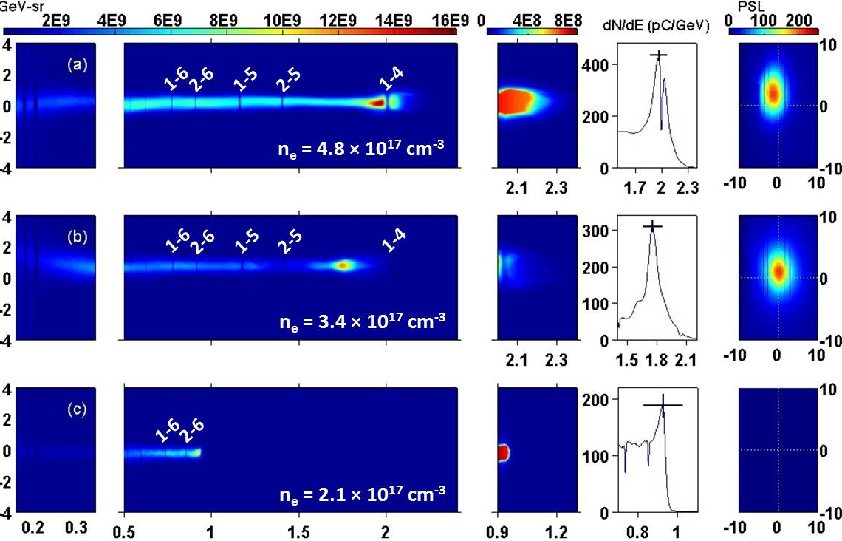
We observe quasi-mono-energetic peaks up to 2 GeV
Wang et al., Nature Commun. 4, 1988 (2013)
• highest energy (2 GeV)
• narrowest divergence (< 0.5 mrad)
• lowest density
low-energy
electrons
GeV electrons
high-energy
tails
vertically integrated
electron spectra
betatron
x-rays
pC/GeV-sr
(PSL)
10% (raw)
65
pC
5% (actual)
1.5 – 2.0 GeV shots reproduced many times!
Angle [mrad]
8% (raw)
Angle [mrad]
35
pC
4% (actual)
self-injected LPA observed
down to 1 x 10¹⁷ cm⁻³
15
pC
Electron Energy [GeV]
GeV
Angle [mrad]

Slide 13
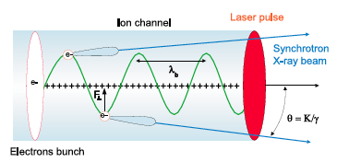
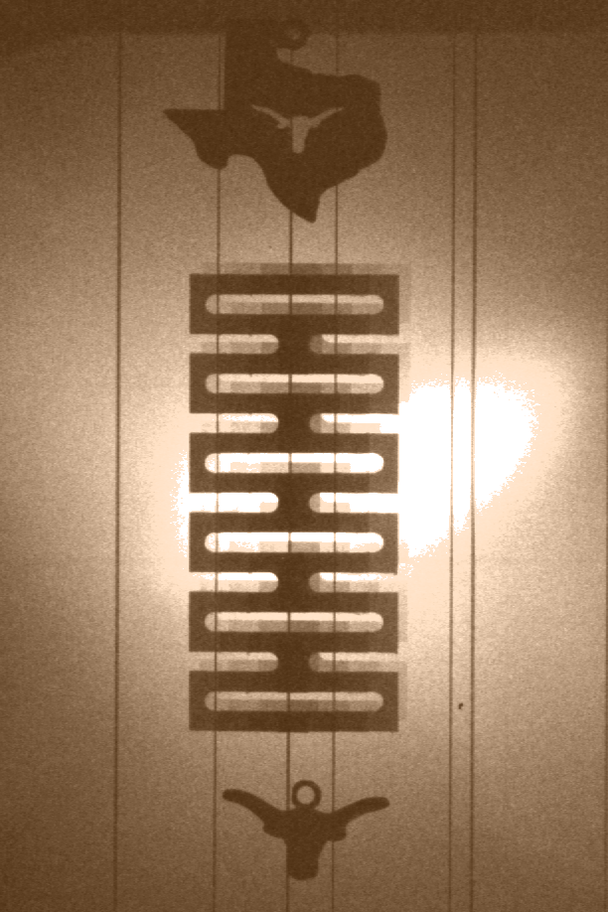
Betatron x-rays: electrons wiggle while accelerating
Rousse, PRL 93, 135005 (2004); Kneip et al., Nature Phys. 6, 980 (2010); Cipiccia et al., Nature Phys. 7, 867 (2011)
0.25 mm
2 mm
Al
mask
25 ± 10 keV r.m.s.
10⁸ - 10⁹ photons
Cipiccia et al.
from 700 MeV LPA
with resonant enhancement
Cu
mask
Kneip et al.
from 200 MeV LPA
(10⁶ – 10⁸ photons)
W wires

Slide 14
OUTLINE
1) Initial 2 GeV PW-laser-driven e- acceleration results
• highest LPA energy to date
• lowest beam divergence (< 0.5 mrad) from an LPA
• lowest plasma density (n_{e} ~ 3e17 cm⁻³) for an LPA
2) How do we improve on these results?
• robust plasma channels at n_{e} ~ 10¹⁷ cm⁻³
• specialized injection techniques yielding ∆E/E < 1%
- density downramp injection
- ionization-induced injection (I³)
- colliding pulse injection
* 4D single-shot laboratory visualization of laser wakes
3) Wider vision of plasma-based accelerators

Slide 15
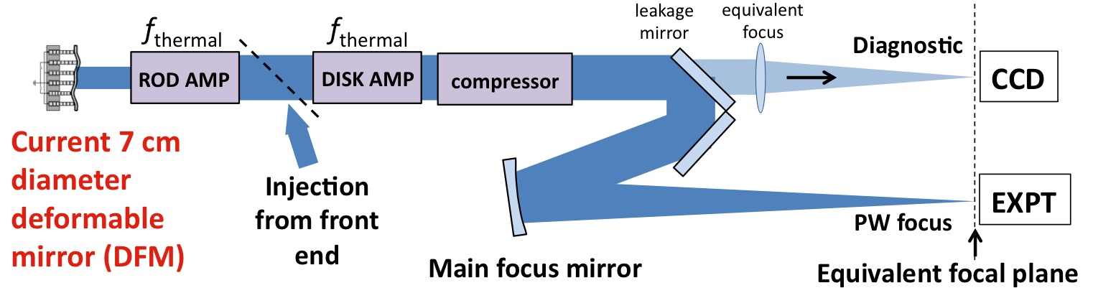
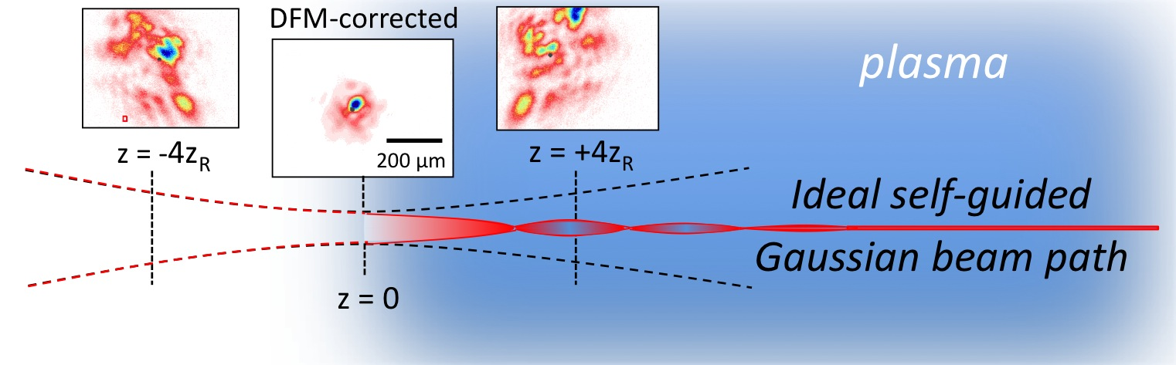
Learning to manage the non-ideal mid-field focus profiles
of big laser systems may improve self-guiding
Focus diagnostic &
correction system:
typical non-Gaussian
amplified laser profile,
fills gain medium
Current 7 cm
diameter
deformable
mirror (DFM)
Planned ~25 cm
diameter DFM
Strehl ~ 0.3
: ~10 cm
actual path: ~3 cm

Slide 16

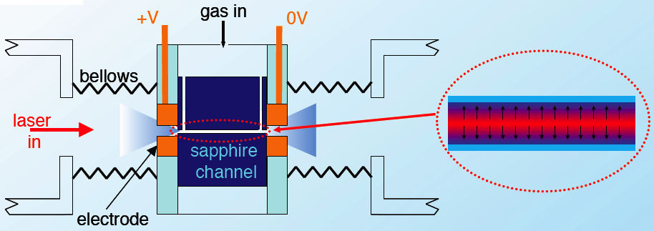
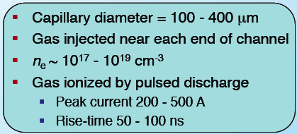
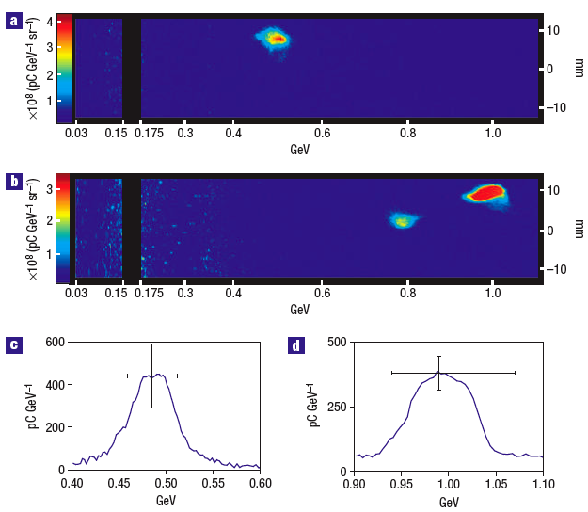
Gas-filled capillary discharge waveguides
extend acceleration length
Oxford U.
Simon Hooker group
Spence, Phys. Rev. E 63, 015401 (2001): Butler, Phys. Rev. Lett. 89, 185003 (2002)
n_{e} is minimum, and refractive index
maximum, on the waveguide axis.
Current Challenges:
• achieve 10¹⁷ cm⁻³ axial density reliably
• shape radial profile to control guided a₀
• avoid wall damage at PW power
• taper longitudinally to enhance L_{d}
Essential to optimizing 30 TW LPA!
n_{e} ~ 10¹⁸ – 10¹⁹ cm⁻³
Leemans et al., Nature Physics 2, 636 (2006)

Slide 17
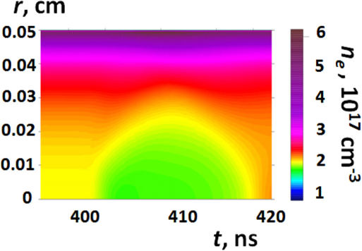
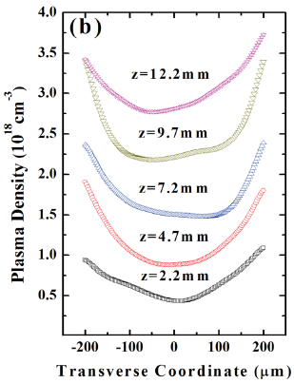

New capabilities in low-n_{e} plasma waveguides are emerging
1) Laser-heater assisted capillary discharge waveguides.
Bobrova et al., Physics of Plasmas 20, 020703 (2013)
1D MHD simulations
laser heater
ns laser
heater
• reduces n_{e} on axis to ~ 10¹⁷ cm⁻³
• creates narrow, controlled guiding profile
• remote from walls, avoiding damage
laser group velocity
2) Longitudinally tapered waveguide
increases wake phase velocity β_{p}
and extends dephasing length L_{d}
Kim et al., APL 102, 204103 (2013)
+V
gas
0 V
z
laser
sapphire channel
n_{e}(z)

Slide 18
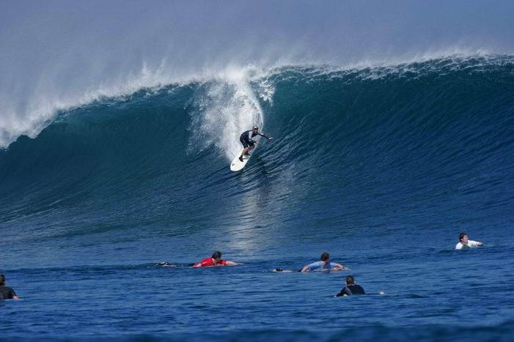
Researchers are working on several approaches to CONTROL
localized injection into a highly nonlinear plasma wave.
Slow the wave
momentarily
(density down-ramp injection)
2) Create moving “surfer”
within the wave
(ionization-induced injection)
dn_{e}/dz < 0
3) Pre-accelerate quiescent “surfers”
in the plasma sea
(colliding-pulse injection)
Notes:
Remind audience that the difficulty of injection is a primary reason that low n_e, multi-GeV LPA was not done earlier.

Slide 19
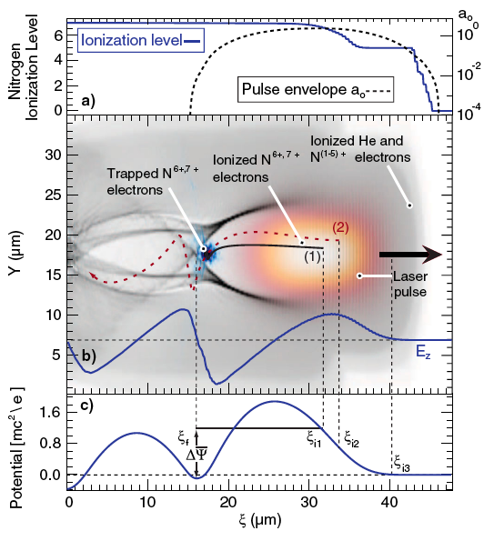
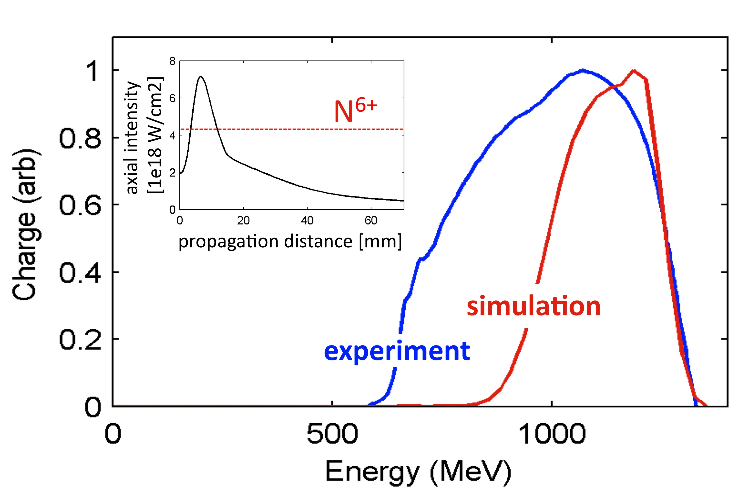

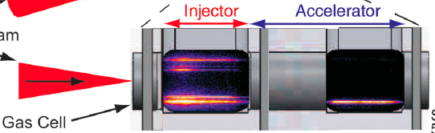
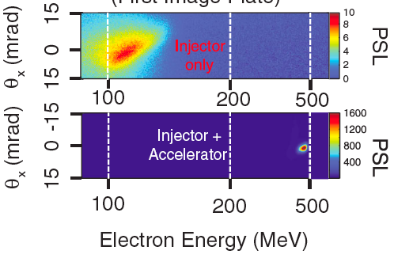
~1% N₂ doping of He plasma enables
Ionization-Induced Injection (I³)
Nitrogen K-shell electrons inject & trap
Result of test shot at Texas PW
Plasma:
n_{e} = 3 x 10¹⁷ cm⁻³ (He)
with 1% N₂ dopant
Laser:
90 J, 150 fs,
f/40 focus
Pak, PRL 104, 025003 (2010)
simulation courtesy Austin Yi
2-stage injector-accelerator can improve beam quality
Pollock, PRL 104, 045001 (2011)
He + N₂
pure He
2-stage gas cell
[MeV]

Slide 20
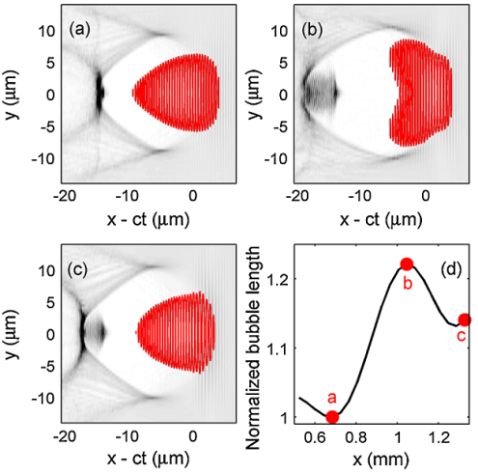
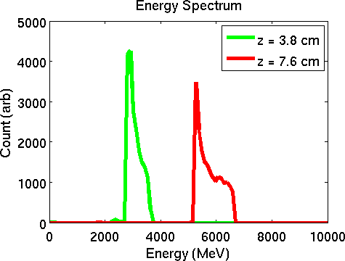
To realize the accelerator’s full potential,
we must learn to SEE it in the laboratory
Kalmykov et al., “Electron self-injection and trapping into an evolving plasma bubble,”
Phys. Rev. Lett. 103, 135004 (2009)
laser pulse focuses,
bubble created
laser pulse defocuses,
bubble expands
laser pulse &
bubble guide
electrons accelerate quasi-monenergetically to ~10 GeV
Plasma bubble
& laser profiles:
3
# electrons [arb.]
electrons inject
1
0
2
4
6
8
10
Energy [GeV]
to
detectors
Texas Petawatt Pulse:
0
5
10
150 J, 150 fs, f/# ~ 40
z [cm]
Self-injected multi-GeV
accelerated electrons
differentially pumped He gas cell
The plasma “bubble” serves 4 functions:
1. cathode
2. laser waveguide
3. electron collimator
4. accelerator
Its structure & dynamics are too important
to leave entirely to theoreticians!

Slide 21

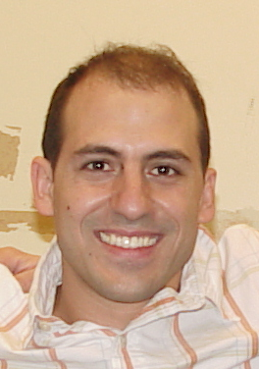
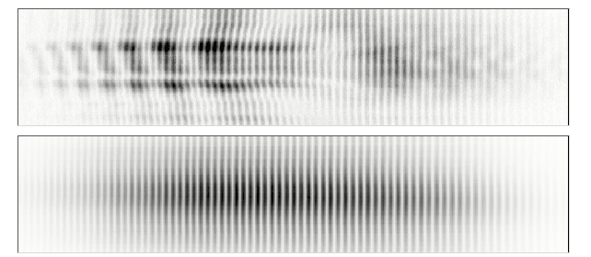
“Frequency Domain Holography” Images Wakefields in a Single-Shot
N. Matlis et al., “Snapshots of laser wakefields,” Nature Physics 2, 749 (2006)
Pump
Pulse
Laser wake
modulates probe
phase & amplitude
(FM & AM)
Ionization
Front
imaging
optics
Chirped
Reference
Pulse
mirror
Chirped
Probe
Pulse
Nicholas Matlis
PhD 2006
(now a Research
Scientist at LBNL)
Fixed Delay
imaging
spectrometer
50
Signal HOLOGRAM
0
-50
distance [∝m]
50
Null HOLOGRAM
CCD
0
-50
390
395
400
405
410
grating
Wavelength [nm]
Notes:
probe illuminate whole object, just like object beam in conventional holography, advanced ref pulse becomes analogue of ref beam in conv. holog, interfere with eachother in recording device which in this case is the CCD of the spectrometer. Because interference happens in spectrometer, we call it frequency domain holography…
To address these issues, we developed a modification to FDI called Frequency Domain Holography, or FDH, capable of measuring temporally-varying features in a single shot. The essence of this modification is to replace the short probes with temporally-long ones that experience phase-shifts from different parts of the wakefield simultaneously. In this experiment the temporally-long probes are generated by chirping (click) the originally short second-harmonic probe pulses to about 1 ps. The chirped probes are relay-imaged onto the slit of an imaging spectrometer where they interfere. The relay imaging provides spatial resolution in the transverse dimension, which is ultimately critical for reconstructing the spatially-varying features of the wakes. As can be seen by this sample raw data, the hologram shows considrably more complexity and thus information than the FDI interferograms which showed a simple overall phase shift.

Slide 22
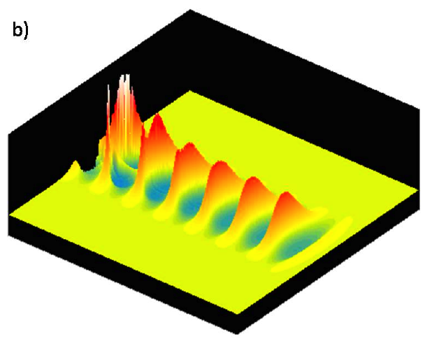
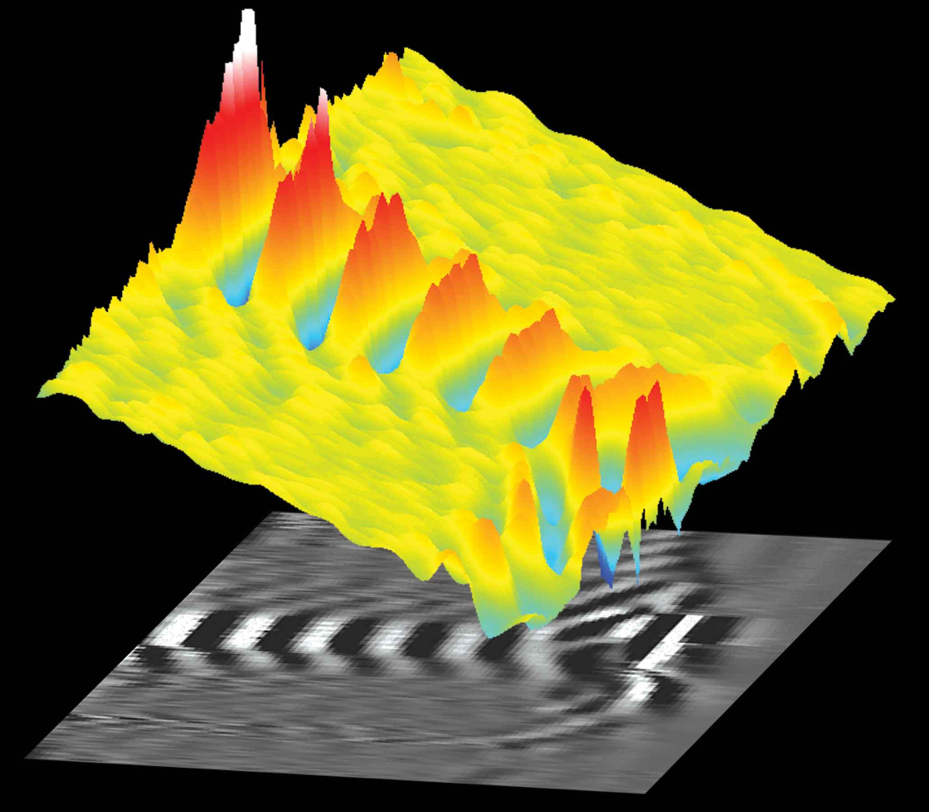
Wakefield snapshots see laser-plasma acceleration physics in unprecedented detail
P. Dong et al., “Holographic Visualization of Laser Wakefields,” New Journal of Physics 12, 045016 (2010).
• relativistic wave front curvature
• peaks grow, narrow & break behind pump
Experiment
Simulation
∆ϕ_{probe}(r,ζ)
n_{e}(r,ζ)
pump
60
60
0.4
0
0
ζ [ps]
r [µm]
r [µm]
0.4
0
60
ζ [ps]
0
60

Slide 23
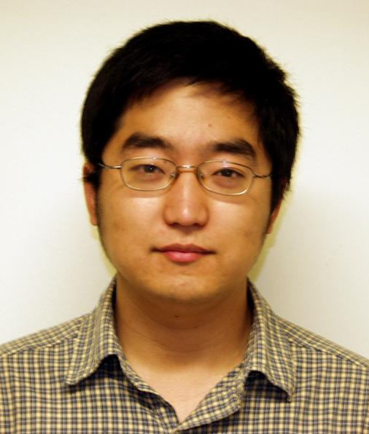




Electron density “bubbles” re-shape co-propagating
probe pulses into optical “bullets”,
allowing us to see & study them directly
P. Dong et al., Phys. Rev. Lett.104, 134801 (2010)
SIMULATIONS
of bubble
Peng Dong
PhD 2010
(now at UC-
San Francisco)
EXPERIMENTS
reconstructed |E_{probe}(r,ς)|
electron spectrum
no gas
unperturbed
probe
no electrons
30 TW pump
1.2•10¹⁹
bubble
forms
no electrons
30 TW pump
Optical bullet
distance from propagation axis [µm]
2.6•10¹⁹
elongated
bubble
poly-
energetic
electrons
3.2•10¹⁹
compact
bubble
mono-energetic
electrons
0
200
400
600
800
1000
20
40
60
80
100
120
time behind pump [fs]
electron energy [MeV]
Probe amplitude [arb.u.]:
0
4
8

Slide 24

Frequency-Domain “Streak Camera”
Records EVOLUTION of Plasma Bubble
in ONE shot
Z. Li et al., Opt. Lett. 35, 4087 (2010)
Research Highlight, Nature Photonics 5, 68 (2011)
Zhengyan Li
phase streak
• Phase streak is a temporal sequence of the object’s projections
• We can record several of them simultaneously to recover
the object’s evolving structure tomographically

Slide 25


Frequency-domain tomography (FDT) records multiple phase streaks in one shot…
3) Phase Streaks
spectrometer
ϕ = 1º
ϕ = 27º
ϕ = -25º
CCD
ϕ = -65º
lens
ϕ = 68º
1) 2D Hologram
medical CT
glass
4) Tomographic
Reconstruction
lens
λ_{probe} [nm]
800 nm
pump
FT
800 nm
probe
gener-
ators
cascaded
4WM
2) Reciprocal 2D Hologram
window
and IFT
400 nm
probes
400 nm
ref. pulse

Slide 26





Single-shot tomographic movies help unravel the complex physics of filament formation in Kerr media
self-guided filament
PUMP
PULSE
ENERGY
nonlinear
refractive
index ∆n
Propagation distance z_{ob} into medium
linear propagation
0.4 µJ
mild self-focusing
0.5 µJ
x_{ob} [µm]
Zhengyan Li 2014
strong self-focusing
Best Technical Short Subject
0.6 µJ
arrested collapse
plasma generation
0.7 µJ
self-guided filament formation
ζ [fs]
Time from peak of pump pulse
Single-shot movie

Slide 27

We have fielded a probe line at the Texas Petawatt
Laser to visualize plasma bubble dynamics directly
Plasma seminar,
Friday
October 25:
Zhengyan Li,
“Single-shot
visualization
of laser-plasma
Interactions”
1
2
3
4
5
6
phase streak
of plasma
bubble
appears as
side scatter
disappears
laser
bubble

Slide 28
OUTLINE
1) Initial 2 GeV PW-laser-driven e- acceleration results
• long pulse PW (Texas)
• short pulse PW (LBNL)
2) How do we improve on these results?
• high PW beam quality
• robust plasma channels at n_{e} ~ 10¹⁷ cm⁻³
• specialized injection techniques yielding ∆E/E < 1%
• 4D single-shot laboratory visualization of laser wakes
3) Vision of future LPA-driven x-ray FELs
• table-top x-ray FELs
• electron/proton-beam-driven plasma electron accelerators
• laser-plasma proton/ion accelerators

Slide 29


* improvements over existing capability
from Altarelli, European X-ray FEL (DESY Tech. Rpt)
1 PW, 150 fs
E = 2 GeV
∆E/E = 0.1 %*
0.1 π mm-mrad
t_{bunch} = 10 fs
I_{peak} = 100 kA
10
2
2
Possible with demon-
strated LPA capability

Slide 30






Plasma
ions
Drive e beam
Accelerating
beam
42 GeV
84 GeV
3.2 km
Nonlinear “bubble” or “blowout” regime
Facility for Advanced
Accelerator Experimental
Tests (FACET) uses SLAC
injector and 2/3 of linac to
deliver compressed 25 GeV
e⁻ and e⁺ drive bunches and
synchronized accelerating
bunches.
Stanford Linear Accelerator Center

Slide 31




Nature Physics 5, 363-367 (2009)
e-
bunch
0 m
150 m
proton
bunch
300 m
450 m
electron witness
bunch:
• 10 GeV
• 1.5 x 10¹⁰ e⁻
plasma:
• n_{e} = 6 x 10¹⁴ cm⁻³
• λ_{p} = 1.35 mm
• L = 600 m
• nonlinear “blowout”
regime
• E_{z} ~ 2 GeV/m
proton driver:
• 1 TeV
• 10¹¹ protons
• σ_{z} = 100 µm
• σ_{x,y} = 0.43 mm
• σ_{θ} = 0.03 mrad
A potential plasma path to
the energy frontier and the ILC

Slide 32




• Needed for clinical therapy:
~ 200 MeV, same energy,
tunable
kT_{hot}
initial accelerating field:
E_{z} ~
λ_{Debye}
~ 10¹⁰ V/cm
virtual
cathode
protons
Laser
pulse
Hydrogen-rich
film
Monoenergetic protons precisely
expose small volumes within the
body ➔ no side effects
Haberberger, Nat. Phys. 8, 95 (2012)

Slide 33


Graduate Students:
• Stefan Bedacht (MS 2009)
• Yen-Yu Chang
• Peng Dong (PhD 2010)
• Dongsu Du (MS 2010)
• Neil Fazel
• Rick Korzekwa
• Spencer Jolly
• Zhengyan Li (Oscar 2014)
• Nicholas Matlis (PhD 2006)
• JC Sanders
• Joey Shaw
• Hai-En Tsai
• Austin Yi (PhD 2012)
• Xi Zhang
Yes, there’s plenty of room --- and plenty of food ---
at the bottom
Postdocs & Senior Scientists:
• Watson Henderson
• Serguei Kalmykov
• Vladimir Khudik
• Chih-Hao Pai
• Xiaoming Wang
• Rafal Zgadzaj
2 GeV
Collaborating Faculty:
• Todd Ditmire
• Mike Downer
• Gennady Shvets
Texas Petawatt Laser Staff:
• Aaron Bernstein
• Ted Borger
• Mike Donovan
• Gilliss Dyer
• Erhard Gaul
• Mikael Martinez
• Hernan Quevedo
• Michael Spinks
bottom feeder
Financial Support:
• U.S. Department of Energy
• U.S. National Science Foundation

Slide 34




Acknowledgements
• Texas LPA team:
Watson
Henderson
e-
diagnostics
Xiao-
ming
Wang
Zhengyan
Li
Neil
Fazel
Rafal
Zgadzaj
Interaction chamber
He
gas
U. S. Department of Energy
U. S. National Science Foundation

Slide 35
END

